Slide 1
data_tructures(&algorithms, lecture04)
Doan Trung Tung, PhD – University of Greenwich (Vietnam)

Slide 2
Plan
Binary Search
01
Recursive Binary Search, Iterative Binary Search, analysis
Tree
02
Tree terminologies, construct a tree, tree traversal
Binary Search Tree
Construct a BST, search on BST, delete notes
03
AVL Tree
Balance tree, rotation operations
04

Slide 3
Binary Search
Recursive Binary Search, Iterative Binary Search, analysis

Slide 4
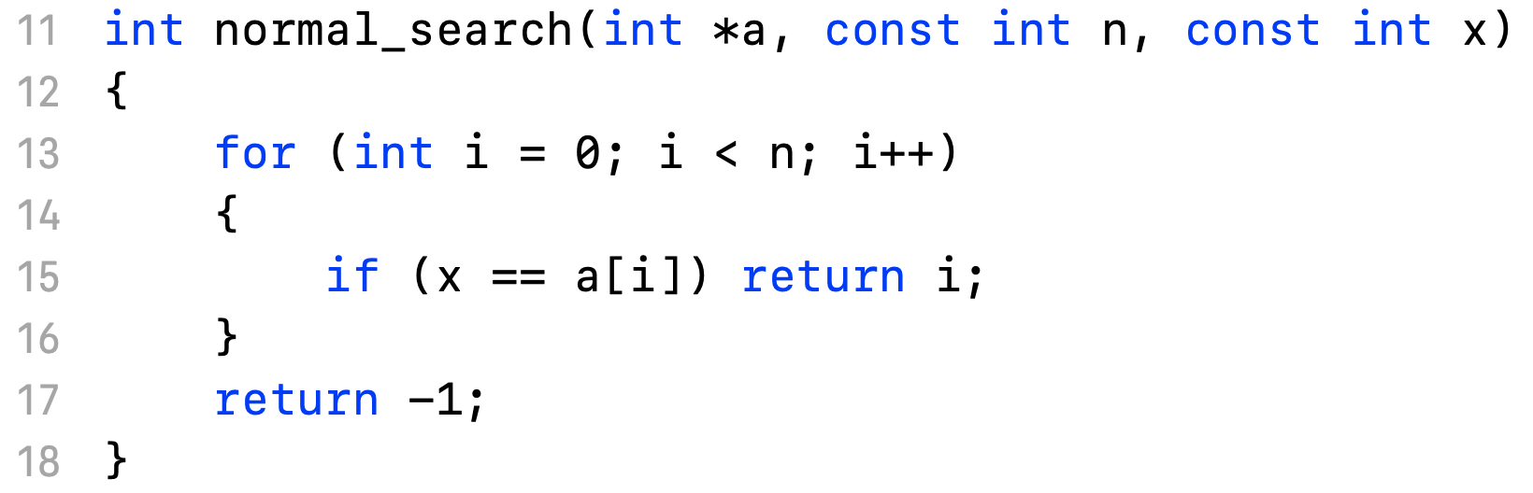
Normal Search
Key idea: going from left to right (or vice versa), looking for x and return found position.
Complexity: O(n)

Slide 5
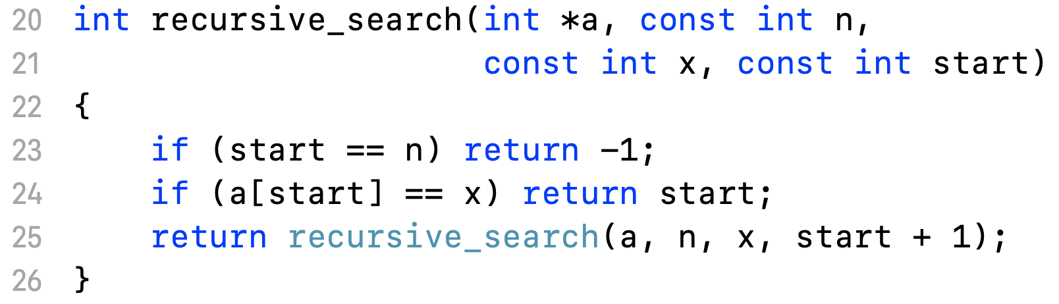
Recursive Search
Base case: start = n => not found
Recursive case: check at start, else recursively check at start + 1

Slide 6
Binary Search
Key idea: for sorted collection, check at the middle and if not found, check only left or right half because the collection is sorted
numbers < mid
numbers > mid
mid

Slide 7
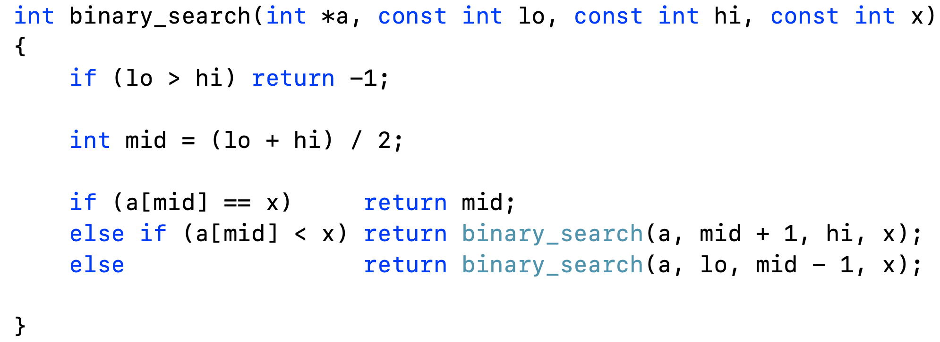
Binary Search
Recursive Implementation: T(n) = T(n/2) + c
Complexity: O(logn)
c
T(n/2)

Slide 8
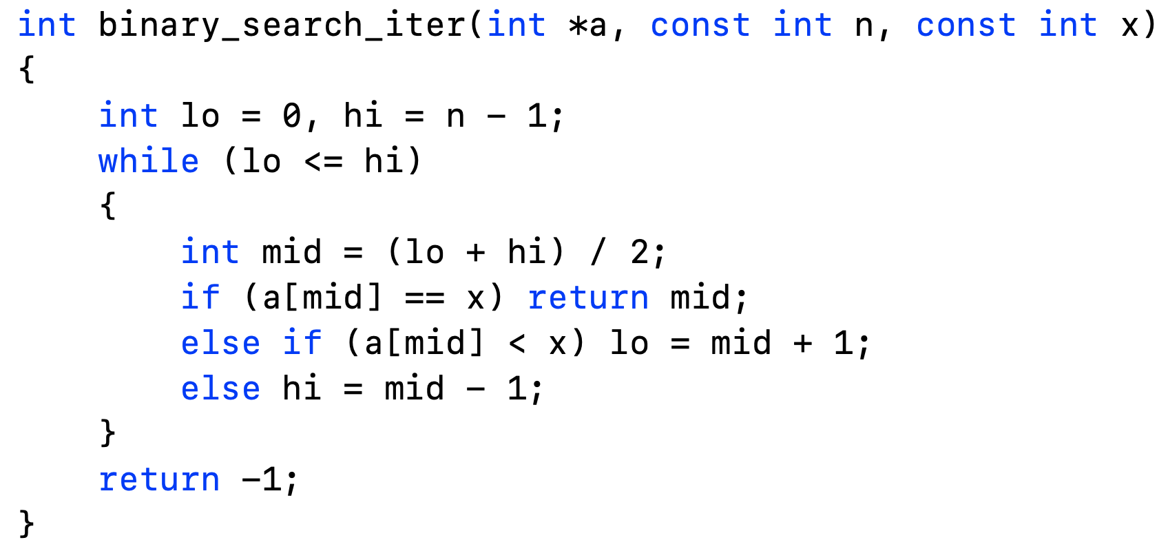
Binary Search
Recursive Implementation: T(n) = c + c + .. + c
= clog(n)
c

Slide 9
Tree
Tree terminologies, construct a tree, tree traversal

Slide 10
What Is A Tree
A tree is an abstract model of a hierarchical structure
A tree consists of nodes with parent-child relation
Applications:
Organization charts
File systems
Programming environments
Every node except one (a root) has a unique parent

Slide 11
Formal Definition
Empty structure is an empty tree
Non-empty tree consists of a root and its children, where these children are also trees

Slide 12
Tree Terminologies
Root: unique node without a parent
Internal node: node with at least one
Leaf: node without children
Ancestors: parent, grandparent, great-grand-parent, …
Descendants: child, grandchild, great-grandchild, etc.
Level: a root is at level 1 (sometimes 0). A father is at level i then its children are at level i+1

Slide 13
Tree Terminologies
Height: maximum level in a tree
Empty tree is a legitimate tree of height 0 (by definition)
A single node is a tree of height 1
Degree (order): number of its children
Each node has to be reachable from the root through a unique sequence of arcs, called path.
The number of arcs in a path is called the length of the path.

Slide 14
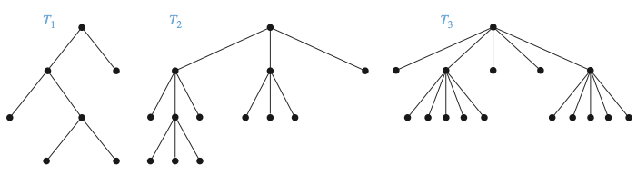
m-ary Trees
Definition: A rooted tree is called an m-ary tree if each vertex has at most m children.
The tree is called a full m-ary tree if every internal vertex has exactly m children.
An m-ary tree with m = 2 is called a binary tree.

Slide 15
Properties of Trees
A tree with n vertices has n – 1 edges
If a full m-ary tree with n vertices, i internal vertices and l leaves then only one of n, i and l can determine the others.
If n vertices, then i = (n - 1) / m and l = [(m − 1)n + 1]/m
If i internal vertices, then n = mi + 1 and l = (m – 1)i + 1
If l leaves then n = (ml – 1)/(m – 1) and i = (l – 1) / (m – 1)

Slide 16

Example: MLM Company
A MLM company starts by one person. Then each person has to find 4 people to sell products and join the network (which are called referrals). Some people can do this, but others cannot. If there are 100 people who cannot find any referrals, then how many people who have referrals and how many people in the company?

Slide 17
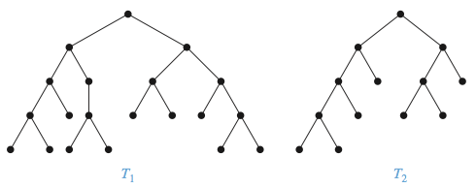
Balanced Trees
An m-ary tree of height h is called a balanced tree if each leave has level h or h−1.
which one is balanced?

Slide 18
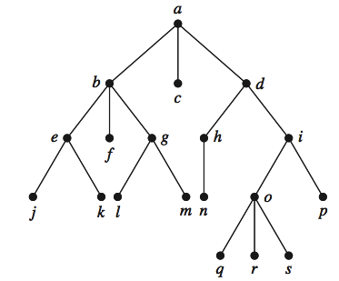
Exercises
Which vertex is the root?
Which vertices are internal?
Which vertices are leaves?
Which vertices are children of j ?
Which vertex is the parent of h?
Which vertices are siblings of o?
Which vertices are ancestors of m?
Which vertices are descendants of b?
Is T a m-ary tree for some positive integer m?
What is the level of each vertex of T?

Slide 19
Excercises
How many vertices does a full 5-ary tree with 100 internal vertices have?
How many leaves does a full 3-ary tree with 100 vertices have?

Slide 20
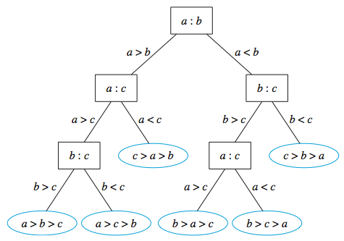
Tree Application: Decision Tree
A rooted tree in which each internal vertex corresponds to a decision that need to choose and each edge incident with it is a possible solution.

Slide 21
Decision Tree Example
Bob is 43, will Bob buy a Sport car?
Mike is 29, will Mike buy a Sport car?
Age
<30
>=30
Car Type
YES
Minivan
Sports, Truck
YES
NO

Slide 22
Tree Application: Huffman Coding
Fixed length Coding
If we use bit strings of length n to represent 26 letters, what is the minimum of n?
What is the disadvantage of using fixed length bit strings?
A → 00001
B → 00010
C → 00011
D → 00100
E → 00101
F → 00110
G → 00111
000110000110100 ←→ CAT

Slide 23
Huffman Coding
Variable length coding
a ~ 0
b ~ 1
c ~ 01
d ~ 10
What does this mean: 0110?

Slide 24
Huffman Coding
Prefix Coding
Code of any character is not prefix of any other character’s code
E | 0
T | 11
N | 100
I | 1010
S | 1011
What does this mean?
11010010010101011

Slide 25
Huffman Coding
Huffman Coding Tree: A binary tree represent prefix codes with their frequencies
100
0
1
a: 45
55
0
1
0
25
30
0
1
0
1
c: 12
b: 13
14
d: 16
0
1
100
101
f :5
e: 9
111
1100
1101

Slide 26
Huffman Coding
Build a binary tree to create prefix codes
Give a message that need to be coded
Write out all distinct letters of the message together with their frequencies. Consider each letter as a binary tree with only one vertex. Call the frequency corresponding to each tree its weight.
At each step, combine two trees whose sum of weights is a minimum into a single tree by adding a new root, and assign this sum of weights as the weight of the new tree.
The algorithm is finished if a single tree is constructed.

Slide 27
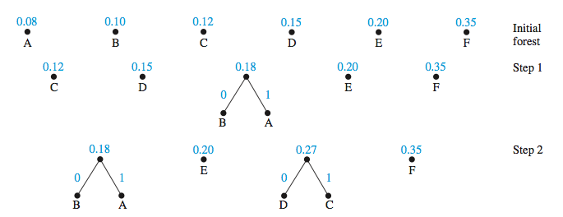
Huffman Coding
Example

Slide 28
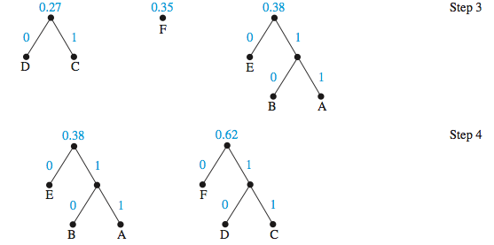
Huffman Coding
Example

Slide 29
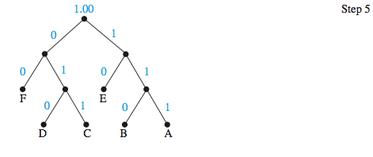
Huffman Coding
Example
A = 111
B = 110
C = 011
D = 010
E = 10
F = 00
What does this mean?
0111110010
Average number of bits:
3 · 0.08 + 3 · 0.10 + 3 · 0.12 + 3 · 0.15 + 2 · 0.20 + 2 · 0.35 = 2.45

Slide 30
Huffman Coding
Exercise
Which of these codes are prefix codes? a) a:11,e:00,t:10,s:01 b) a:0,e:1,t:01,s:001 c) a:101,e:11,t:001,s:011,n:010 d) a: 010, e: 11, t: 011, s: 1011, n: 1001, i: 10101
Use Huffman coding to encode these symbols with given frequencies: A: 0.10, B: 0.25, C: 0.05, D: 0.15, E: 0.30, F: 0.07, G: 0.08. What is the average number of bits required to encode a symbol?

Slide 31
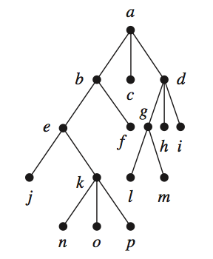
Tree Traversal: Pre-order
Visit the root
Traverse each of T₁, T₂, ...,T_{n} in preorder.
a b e j k n o p f c d g l m h i

Slide 32
Tree Traversal: In-order
Traverse left child in In-order.
Visit the root.
Traverse each of right children in In-order
j e n k o p b f a c l g m d h i

Slide 33
Tree Traversal: Post-order
Traverse each of T₁,T₂,...,T_{n} in Post-order.
Visit the root.
j n o p k e f b c l m g h i d a

Slide 34
Binary Search Tree
Construct a BST, search on BST, delete notes

Slide 35
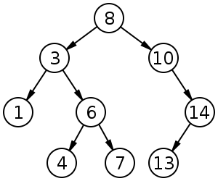
Binary Search Tree
A Binary Search Tree is a binary tree with the following properties:
Each child of a vertex is designated as a right or left child, no vertex has more than one right child or left child
Each vertex is labeled with a key which is both larger than the keys of all vertices in its left subtree and smaller than the keys of all vertices in its right subtree

Slide 36
Binary Search Tree
Start with a tree containing just one vertex, namely, the root.
The first item in the list is assigned as the key of the root.
To add a new item, first compare it with the keys starting at the root and moving to the left if the item is less than the key of the respective vertex if this vertex has a left child. Do the same for the right child.
When the item is less than the respective vertex and this vertex has no left child, then a new vertex with this item as its key is inserted as a new left child. Do the same for the right child

Slide 37
Binary Search Tree
Construct a BST from a list {4, 9, 12, 8, 3, 10, 7}
4
3
9
8
12
7
10

Slide 38
Binary Search Tree
Search an element in BST: O(logn)
Search number 13?
4
3
9
8
12
7
10

Slide 39
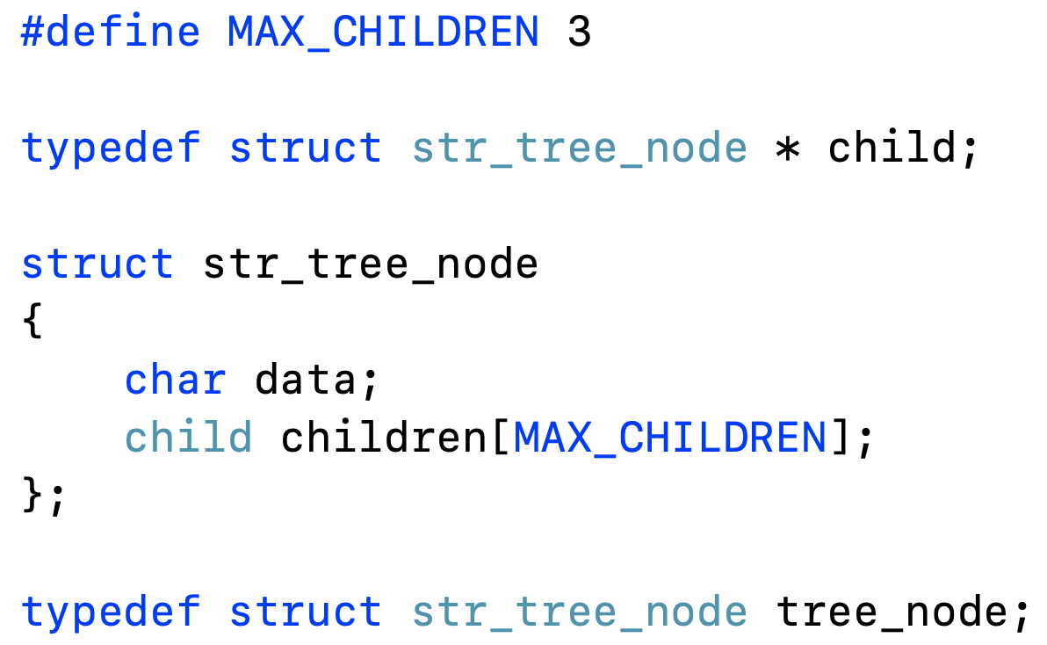
m-ary Tree Implementation & Traversal
Define tree structure

Slide 40
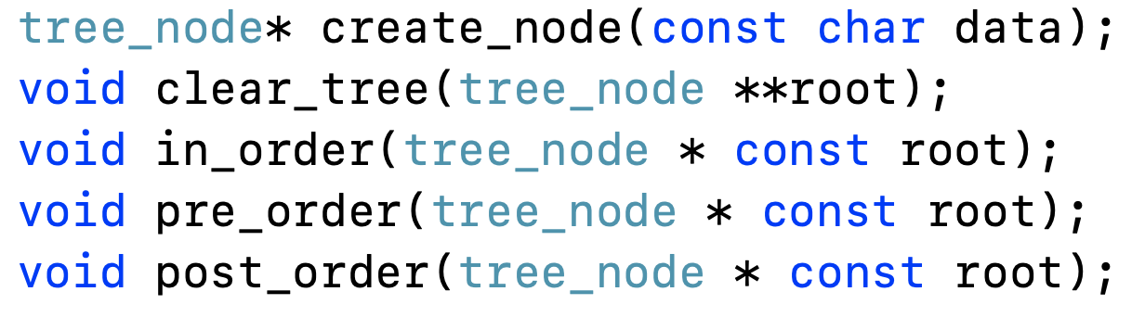
m-ary Tree Implementation & Traversal
Define tree operations

Slide 41
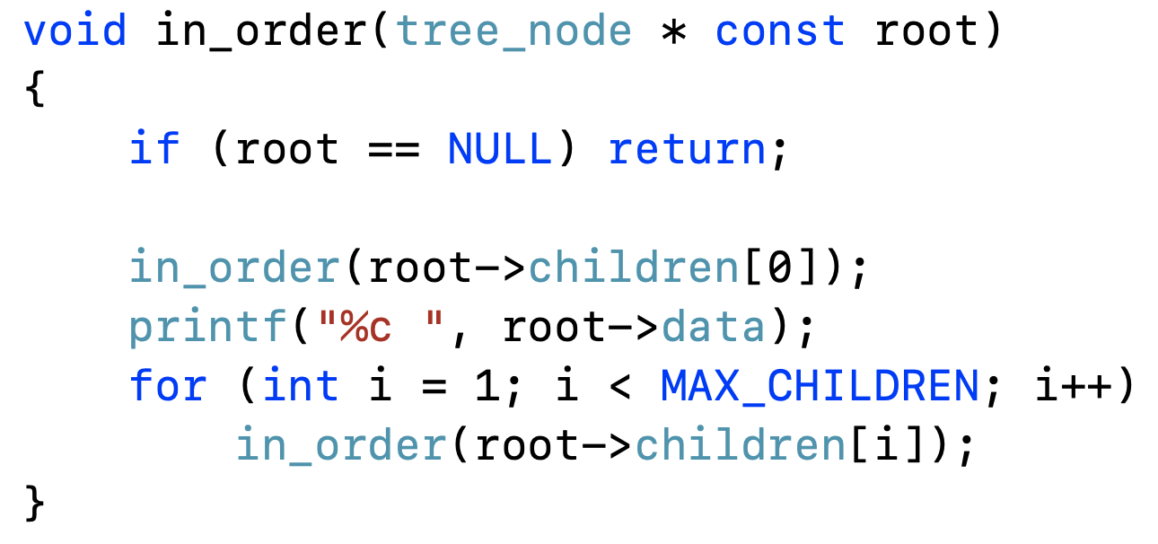
m-ary Tree Implementation & Traversal
In-order traversal

Slide 42
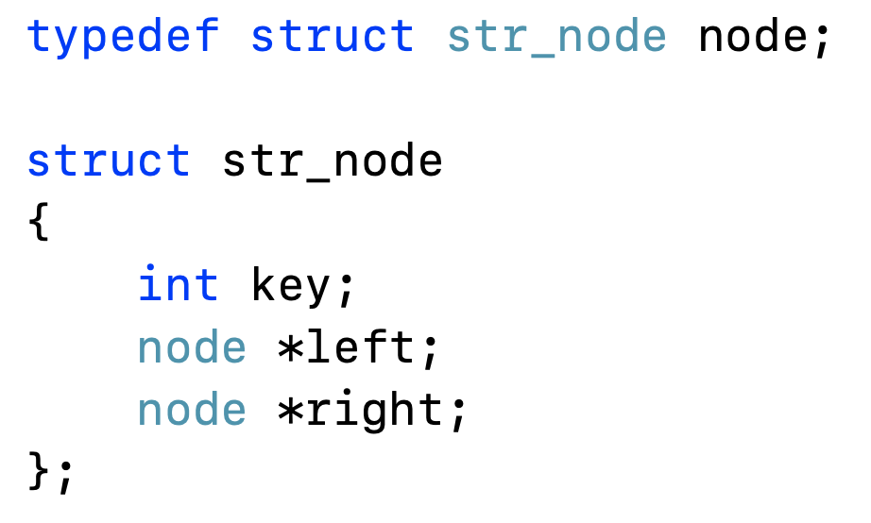
Binary Search Tree Implementation
Declare BST structure

Slide 43
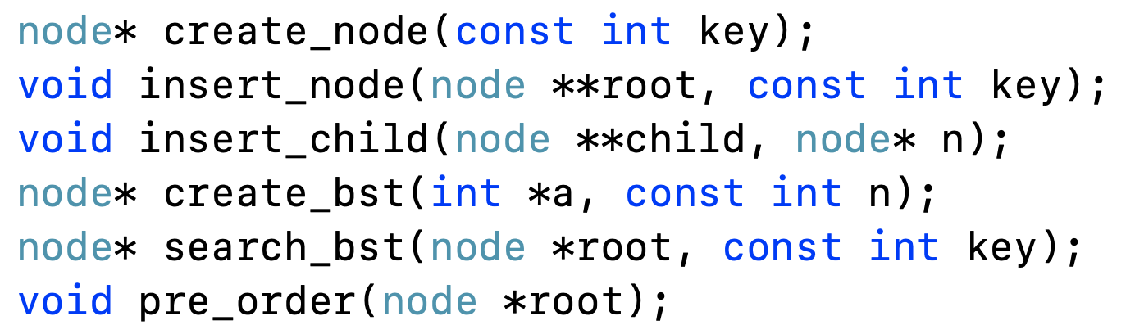
Binary Search Tree Implementation
Declare BST operations

Slide 44
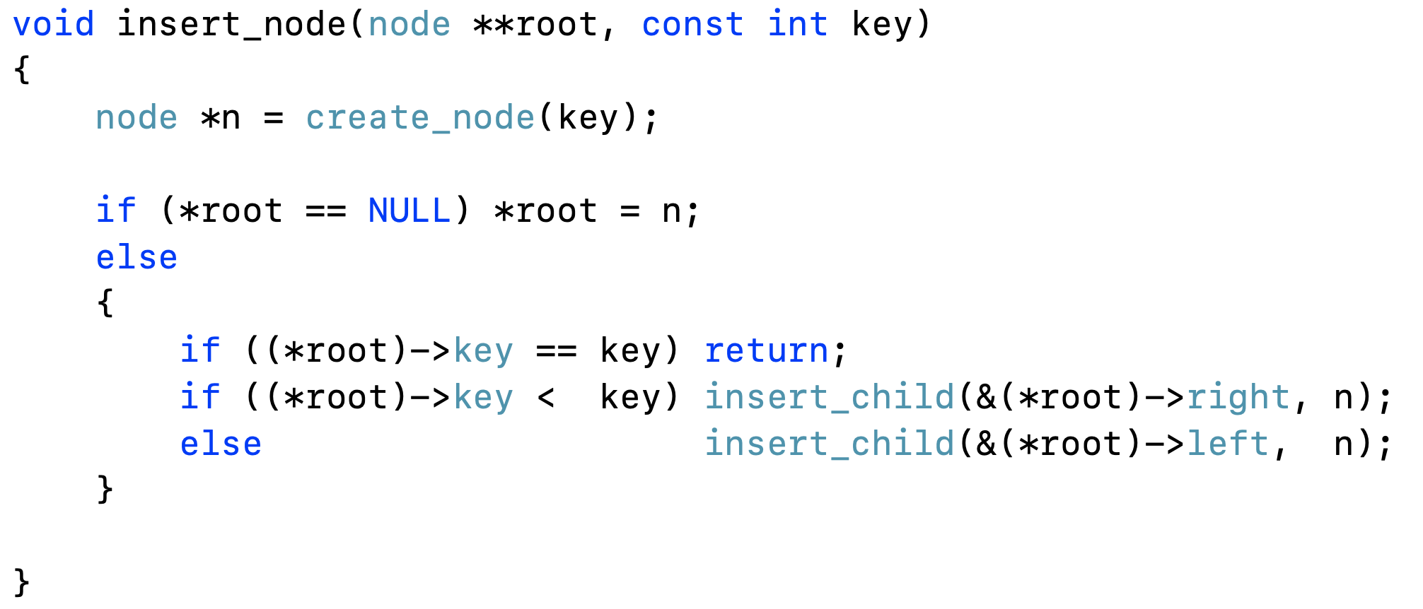
Binary Search Tree Implementation
Define BST operations

Slide 45
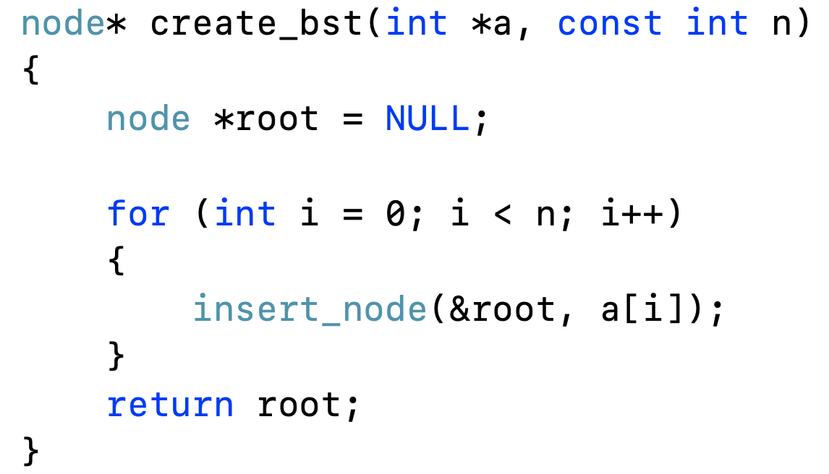
Binary Search Tree Implementation
Define BST operations

